Slide 1
The FAFSA Made Easy
A Guide to Completing the FAFSA Online

Slide 2
What You Need to Know
Must file every year in college
Can file beginning October 1st of your senior year
Must make and record FSA ID (Parent/Student)
The earlier FAFSA completed the BETTER!!

Slide 3
How Do Individuals Apply?
Free Application for Federal Student Aid (FAFSA)
www.FAFSA.gov
Search and open website
3

Slide 4
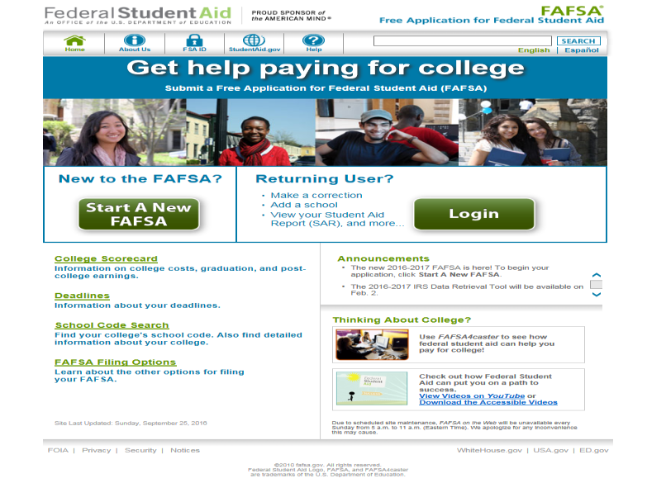
Source: www.fasfa.gov
Notes:
FAFSA on the Web home page (www.fafsa.gov).

Slide 5
Never filled out FAFSA?
Press “Start a New FAFSA” button
Filled out FAFSA last year?
Press “Login” button

Slide 6
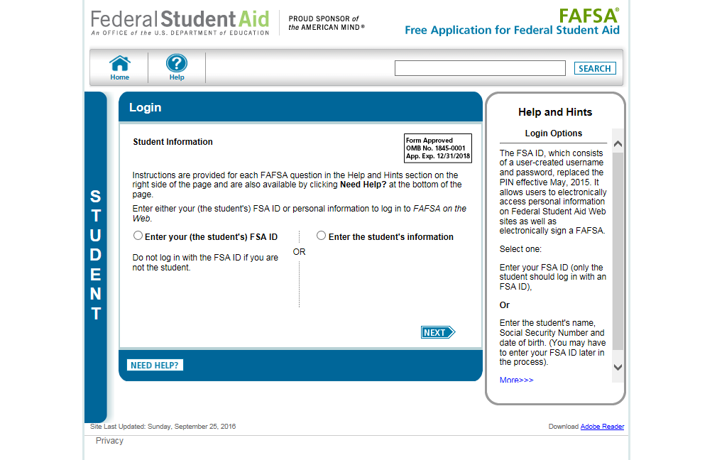
Source: www.fasfa.gov
Notes:
This is the “Login” page. Because the FAFSA is ALWAYS the student’s application (rather than the parent’s), the student inputs his or her information first. The personal identifying information entered here will form the record locators within the FAFSA database.

Slide 7
Student Information
Before you click to input student information, be sure to choose and RECORD (some place you can easily find it; maybe in your phone!) your FAFSA-ID and password. You will use this every time you log into FAFSA, so choose carefully. Be sure to write it down in at least two separate places. Be sure to label it FAFSA!
THEN,
Click on and enter your FAFSA-ID and press NEXT.

Slide 8
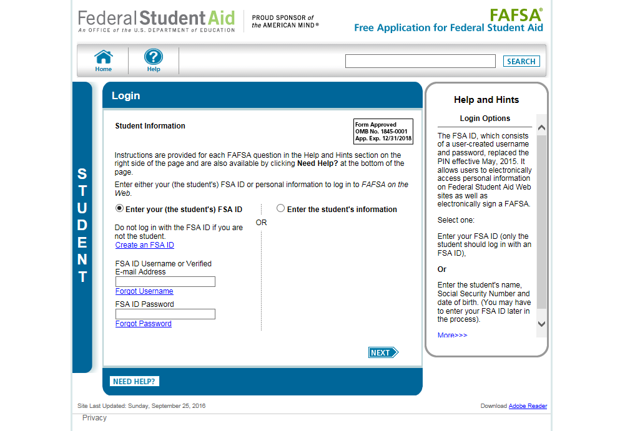
Source: www.fasfa.gov
Notes:
“Login” page with Enter your FSA ID option selected.
Note: It is beneficial for the student/parent to include an e-mail address on his/her FSA ID account to allow the U.S. Department of Education to communicate directly with the FSA ID owner about the status of his/her account. The e-mail address is entered when the student/parent applies for his/her FSA ID.
Reminder: While the e-mail address for FSA ID is optional, if the user does want to include an e-mail address, it can be used only once with an FSA ID. If users share an e-mail address, only one user may link the e-mail address to an FSA ID.

Slide 9
NEXT, Fill in you first name. Do NOT use your nickname or a shortened version of your name. FAFSA is a government form and the name you put on it must be your LEGAL first name (even if you hate your name and can’t wait until you can legally change it!). After all, you want the college to recognize your name well enough to give you money for college.
THEN, fill in your last name, your social security number (be sure to check it twice) and your birth date (mmddyyyy). That means if the month of your birth is a single digit---like June is 06---then enter it with a zero preceding it. Same rule goes for the day of your birth---June 7 would be expressed as 0607. Check all to be sure all are correct. Press NEXT.

Slide 10
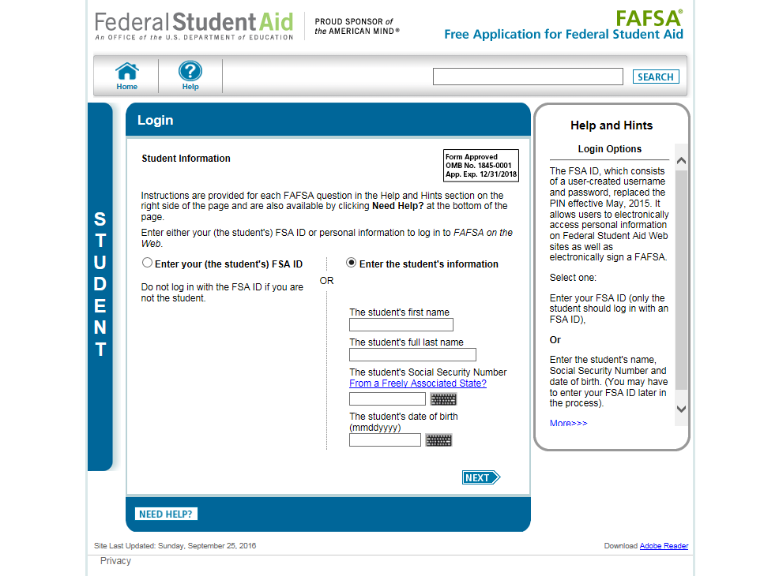
Source: www.fasfa.gov
Notes:
“Login” page with Enter the student’s information option selected.

Slide 11
The next page needs no explanation,
just a CAUTION! Be sure to click the school year for which you are filing the FAFSA.
Don’t worry! Your FAFSA application will have the proper years to choose.

Slide 12
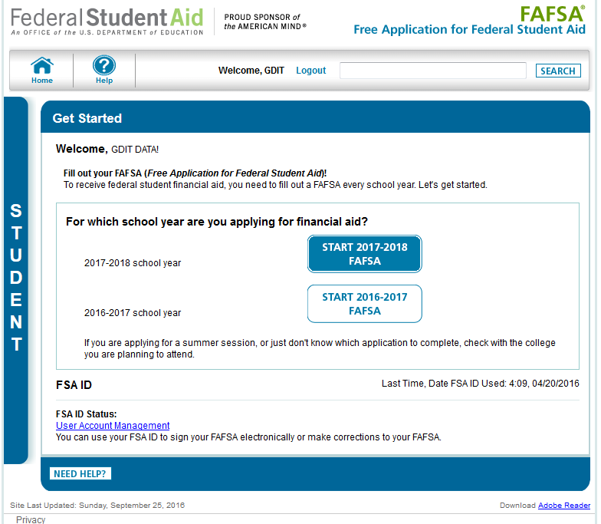
Source: www.fasfa.gov
Notes:
“Get Started” page.
This page was revised to provide clarification on which school year the applicant should apply for based on the school year they are planning to attend college.
The applicant can view the status of his/her FSA ID in the FSA ID section of the My FAFSA page.

Slide 13
????????
I know! I know! Now it asks you to make a FAFSA-ID. You must fill in the blanks, but smile): you are already ahead!
Press CONTINUE, when you have completed the page. The next page is just an example page that was completed for you.

Slide 14
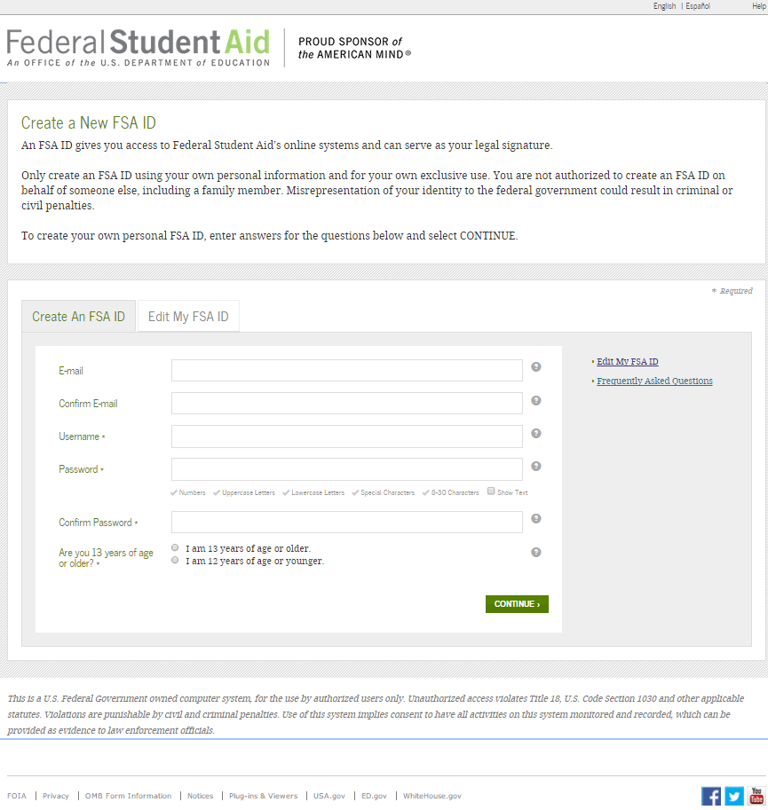
Source: www.fasfa.gov
Notes:
After Melanie (The Student) clicked on Create an FSA ID – she was directed to the “Create a NEW FSA ID” page.
Disclaimer: The student and parent cannot share the same FSA ID. The student must apply for an FSA ID and the parent must apply for an FSA ID. An FSA ID serves as part of a person’s identification, as well as their electronic signature, and should only be used by that individual. That also means that the student and the parent should not use the same email address linked to the FSA ID.

Slide 15
More of the same……
Answer the questions as they are asked

Slide 16
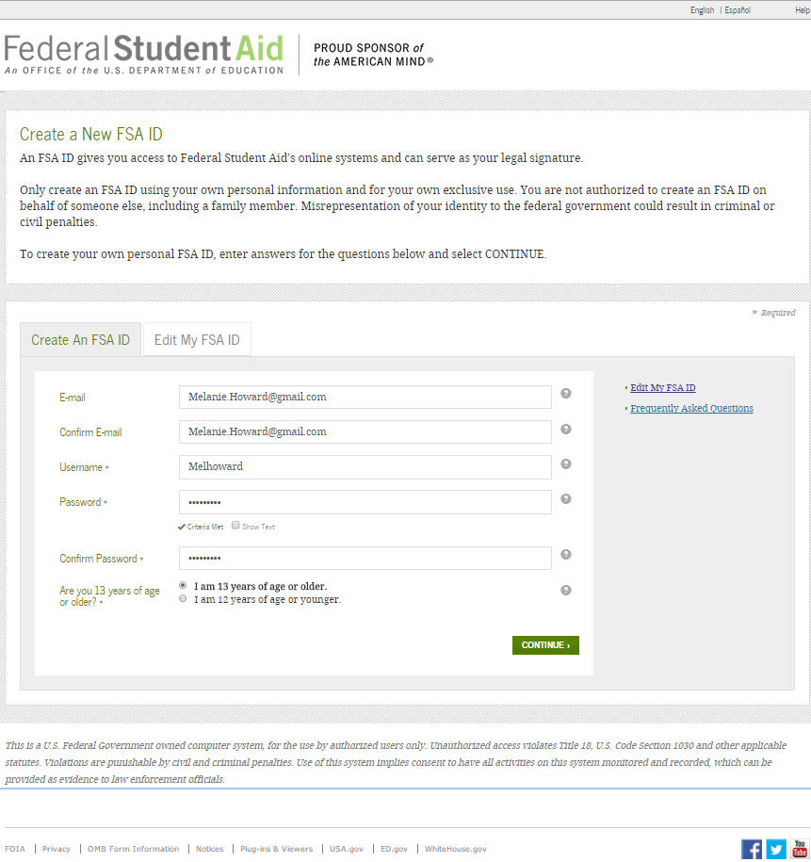
Source: www.fasfa.gov
Notes:
The FSA ID process consists of four main steps of entering the following log-in information:
Provide your e-mail address, a unique username, and password, and verify that you are at least 13 years old as completed by Melanie.

Slide 17
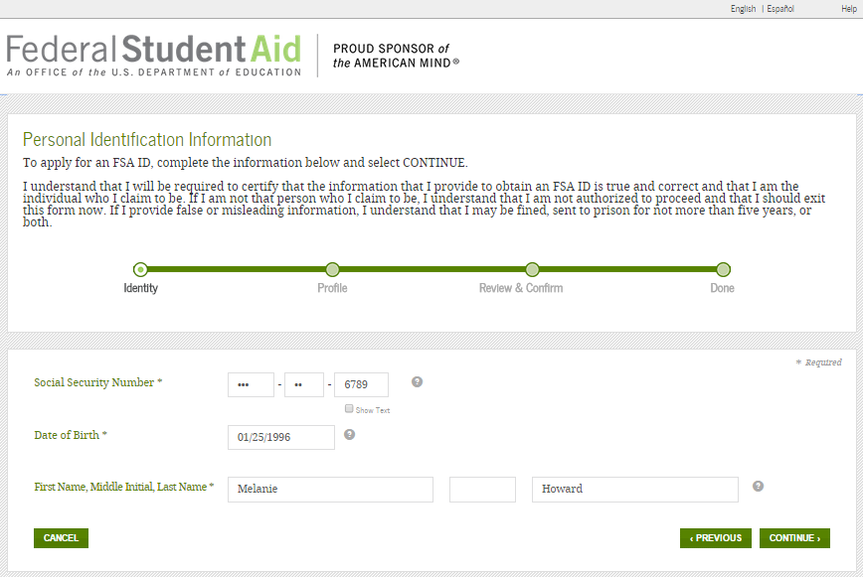
Source: www.fasfa.gov
Notes:
Enter your personal information.
Provide your Social Security number, full legal name, and date of birth as shown by Melanie.

Slide 18
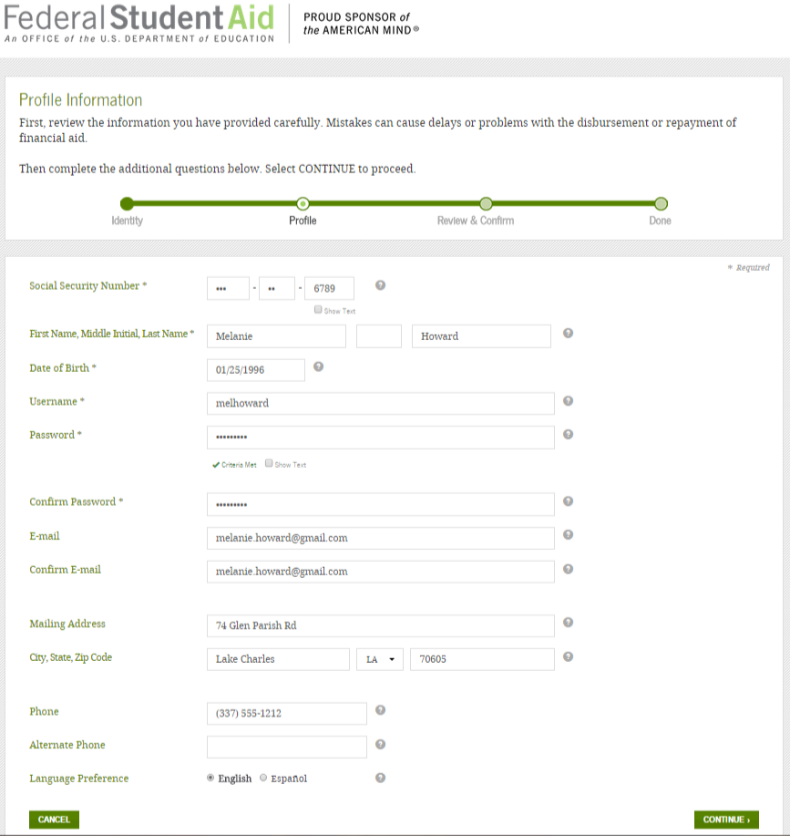
Source: www.fasfa.gov
Notes:
Include your mailing address, e-mail address, telephone number, and language preference as shown by Melanie.

Slide 19
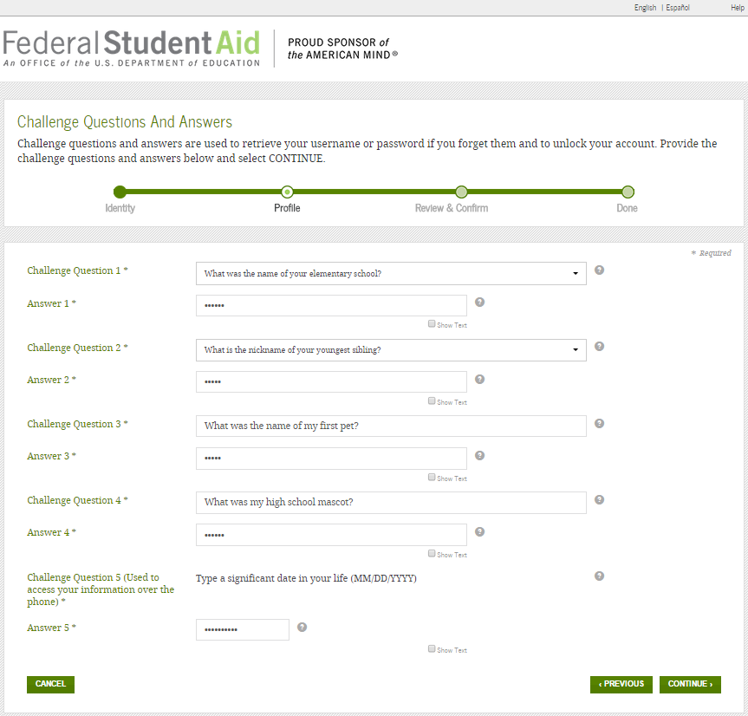
Source: www.fasfa.gov
Notes:
For security purposes, provide answers to five challenge questions. The first two challenge questions are available from a drop down menu; however, the remaining three, Melanie must create her own challenge questions and answers.

Slide 20
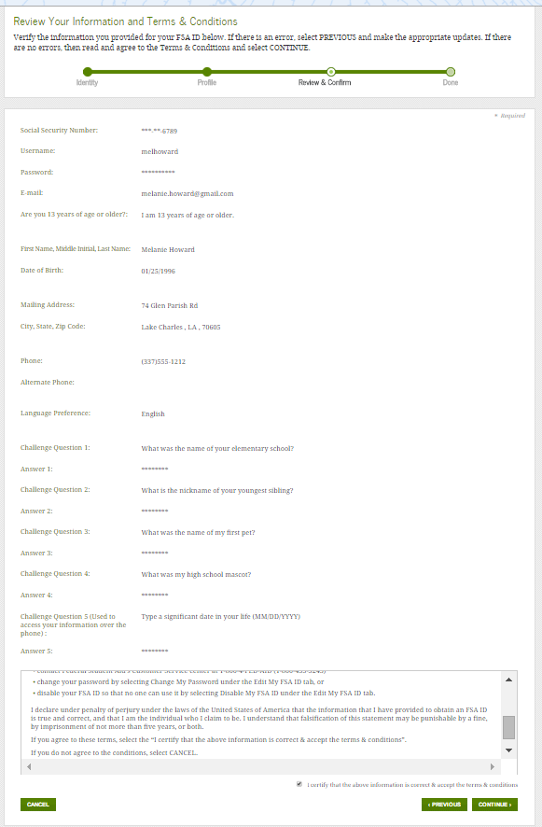
Source: www.fasfa.gov
Notes:
Submit your FSA ID information.
Agree to the terms and conditions.
Verify your e-mail address. (Note: By verifying your e-mail address, you can use your e-mail address as your username when logging into certain ED websites. This verification also allows you to retrieve your username or reset your password without answering challenge questions.)
Please refer to the disclaimer on slide 11

Slide 21
NEXT, it is going to ask you to make a SAVE key. Not a hard thing to do but WRITE it down and label it SAVE KEY. Put it with your FAFSA-ID and password!

Slide 22
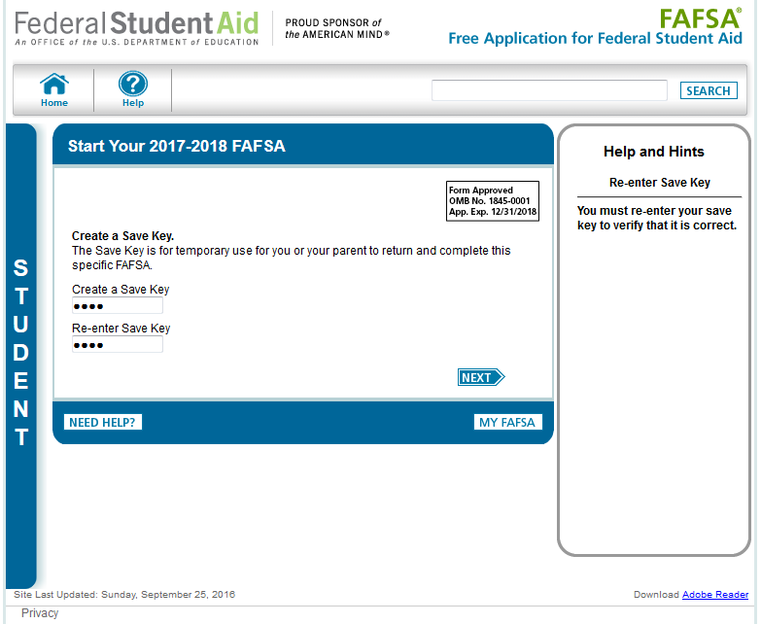
Source: www.fasfa.gov
Notes:
The “Save Key” allows an applicant to save his/her FAFSA application and return at a later time to complete and submit the application. The application is saved for 45 days or until the student submits his/her application for processing. Additionally, the Save Key allows applicants a way to share their application with their parents.

Slide 23
The NEXT page will show you a selection of links to find information you might need. Otherwise, move to the next slide.

Slide 24
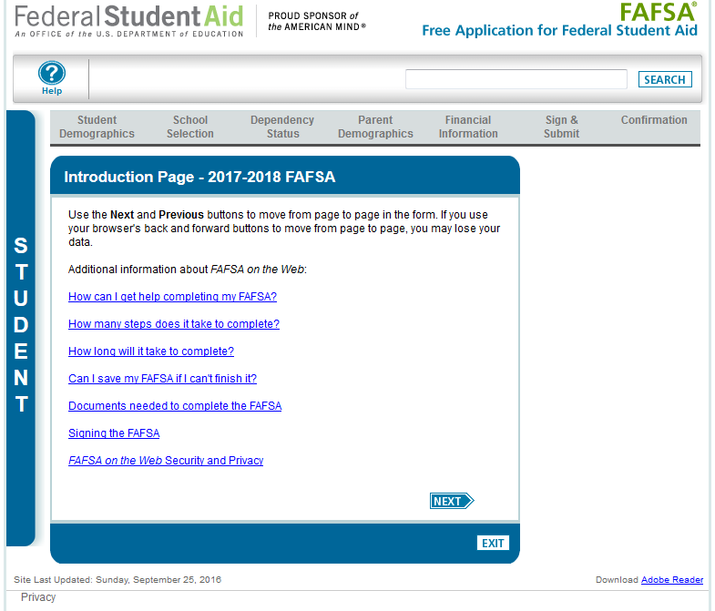
Source: www.fasfa.gov
Notes:
“Introduction Page”.

Slide 25
NEXT, these pages are called demographic information. No worry! Name, SS number, address, you know: demographics! Try that word on your friends.

Slide 26
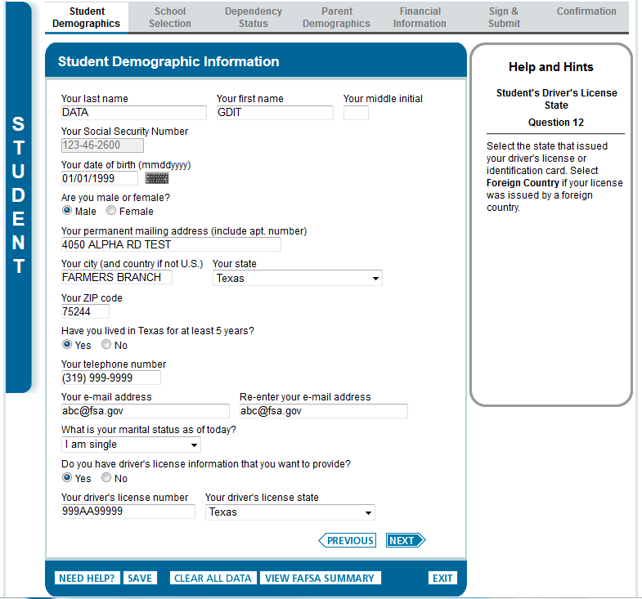
Source: www.fasfa.gov
Notes:
“Student Demographic Information” page.

Slide 27
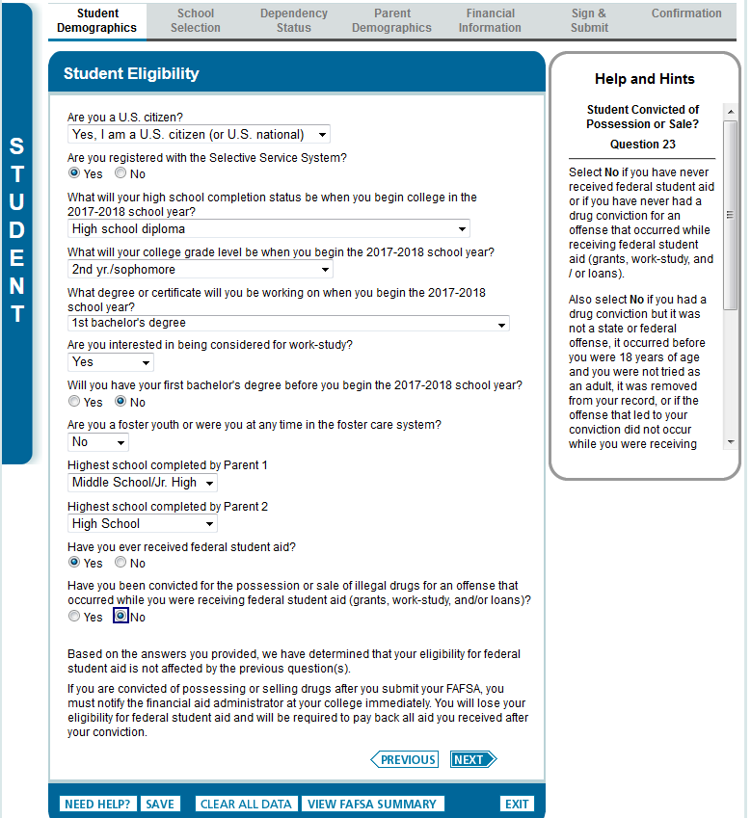
Source: www.fasfa.gov
Notes:
“Student Eligibility” page.
The word “college” was added to the question “What will your college grade level be when you begin the 2017-18 school year?”

Slide 28
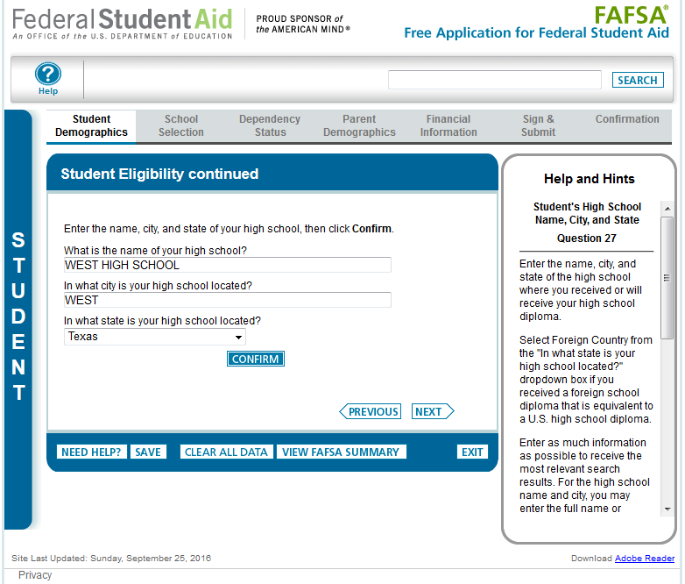
Source: www.fasfa.gov
Notes:
“Student Eligibility continued” page.

Slide 29
NEXT, this page is for you to enter the names of colleges or universities you are seriously interested in attending. Do not waste your FAFSA application on your “dream” schools. The ones you list here are the schools that might give you money to help pay tuition and stuff: serious school choices!

Slide 30
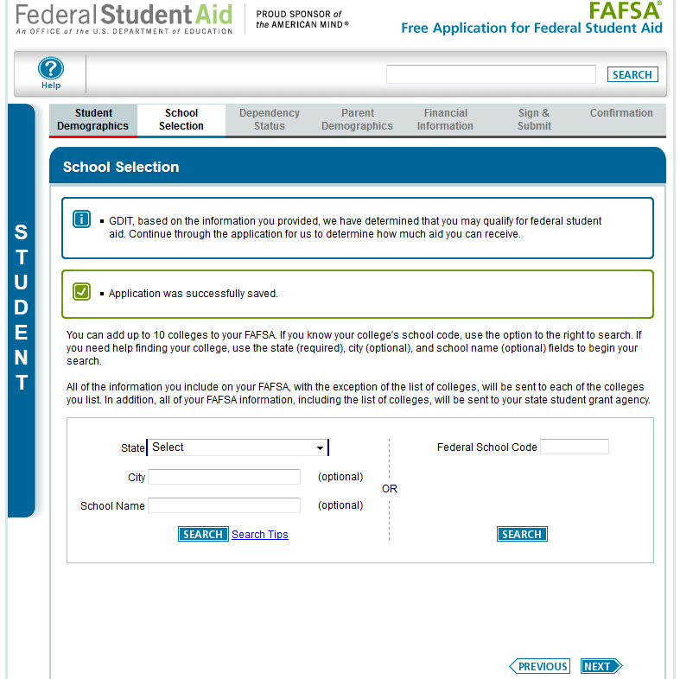
Source: www.fasfa.gov
Notes:
“School Selection” page.

Slide 31
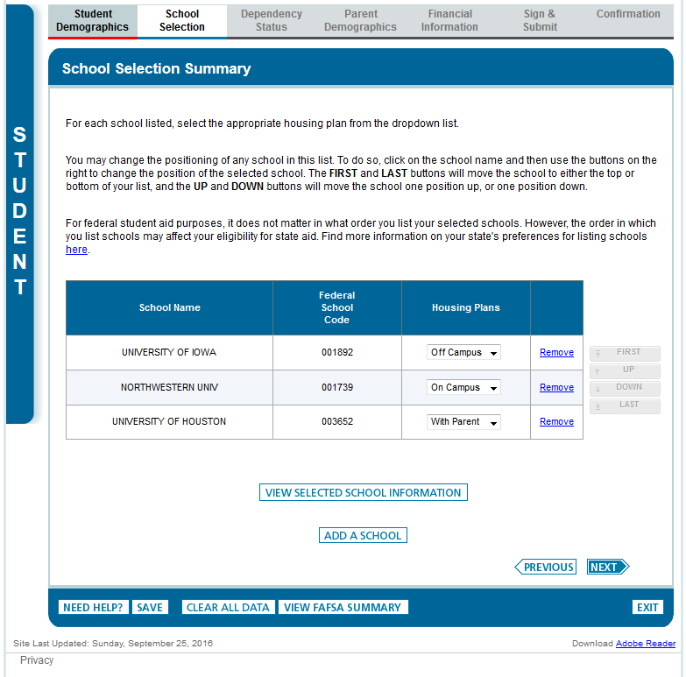
Source: www.fasfa.gov
Notes:
“School Selection Summary” page.

Slide 32
The NEXT pages are concerned with Dependency Determination. That simply means that this page starts gathering information about your parents to help FAFSA decide how much financial aid you will be eligible for and how much your parents should be able to provide for your college education.
REMINDER AND CAUTION: This is a legal form provided by the United States government. Be very truthful in answering all the questions!

Slide 33
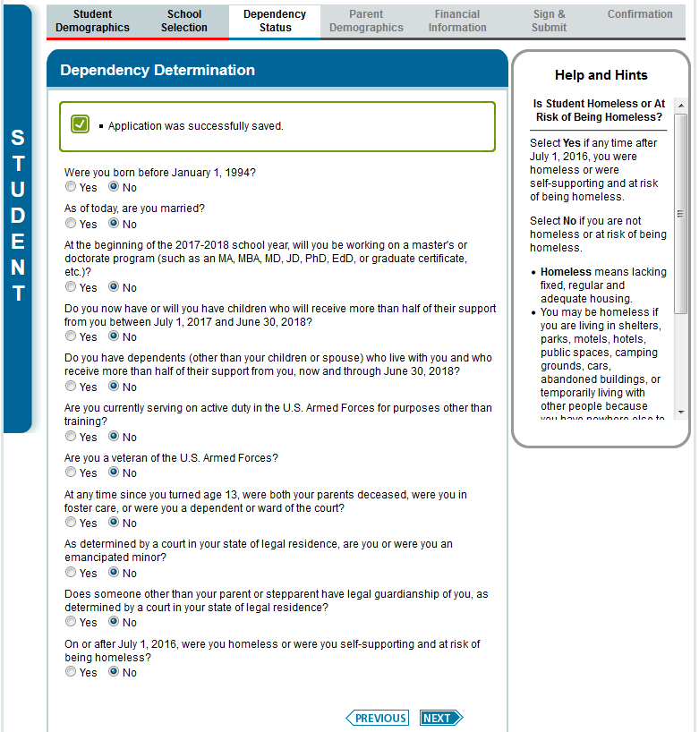
Source: www.fasfa.gov
Notes:
“Dependency Determination” page.

Slide 34
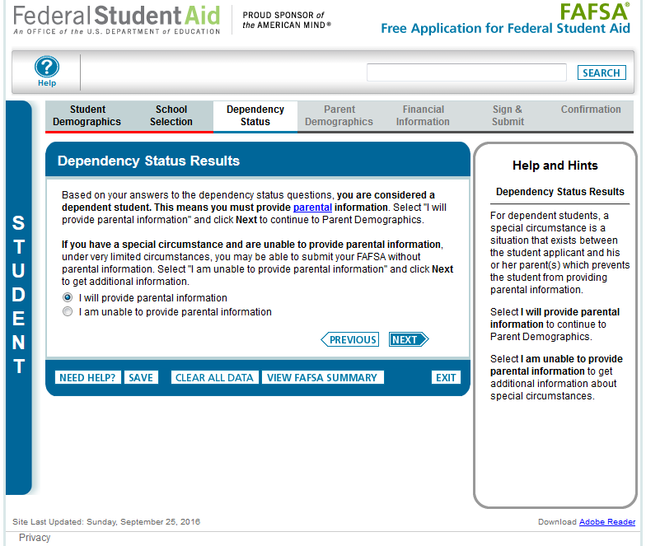
Source: www.fasfa.gov
Notes:
“Dependency Status Results” page.
This page only displays if the applicant has been determined to be dependent.

Slide 35
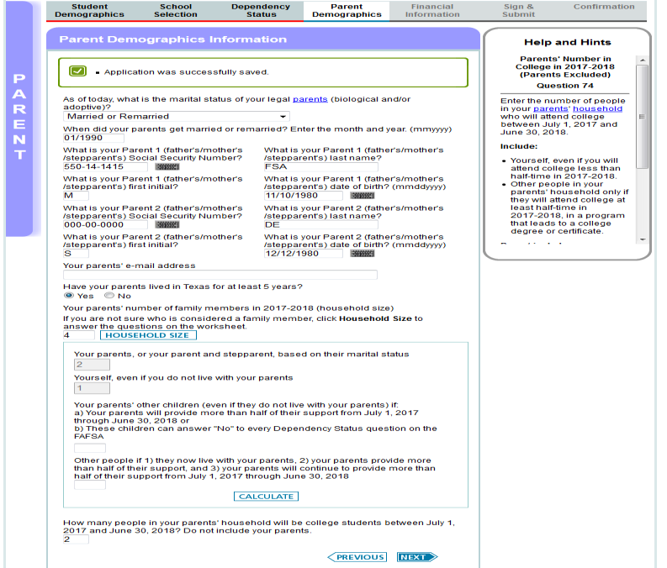
Source: www.fasfa.gov
Notes:
“Parent Demographic Information” page. NOTE: Information in this portion pertains to the parent

Slide 36
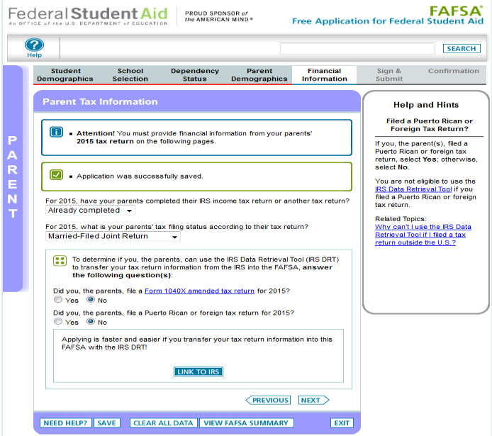
Source: www.fasfa.gov
Notes:
“Parent Tax Information” page.
New for 2019-20, the 2017 tax information will be requested instead of the 2018 tax information. To emphasize this change for students and parents, an alert message will display indicating “Attention! You must provide financial information from your parents’ 2017 tax return on the following pages.”
Additionally, the IRS Data Retrieval Tool (DRT) section of the application has been revised to make the following changes:
The “Did you, the parents, file taxes electronically in the last 3 weeks (or by mail in the last 11 weeks)?” question has been removed.
Parents will not be requested to provide their FSA ID (if not already provided) on the “Parent Tax Information” page prior to clicking “Link to IRS”
The Amended Tax Return and Foreign Tax Return questions have been revised to include 2015 as part of the question.
The definition of the 1040 X amended tax return can be found by following the link that was added to the question.

Slide 37
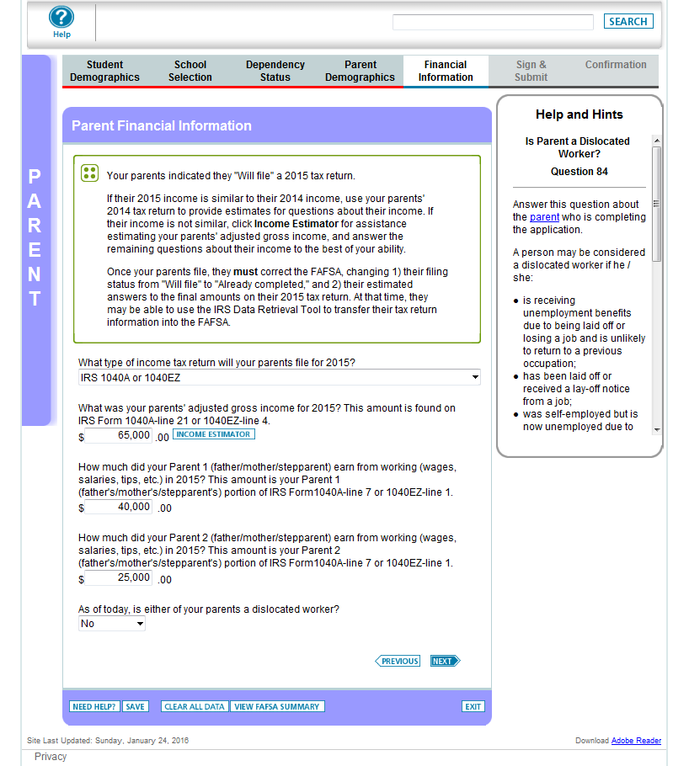
Source: www.fasfa.gov
Notes:
Now we’re going to list some basic income information for Melanie’s parents.

Slide 38
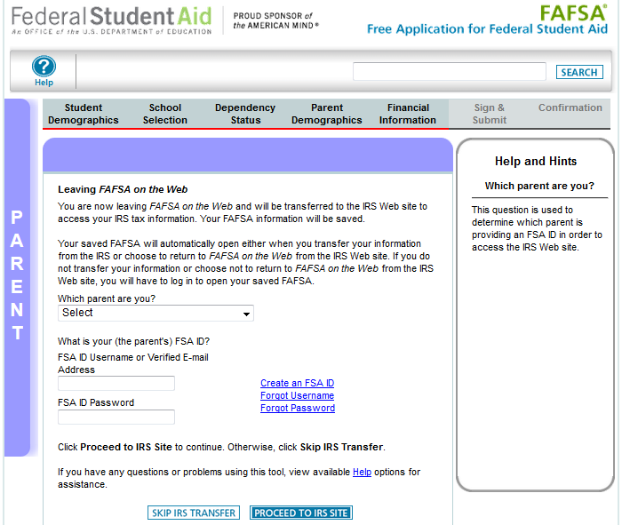
Source: www.fasfa.gov
Notes:
“Leaving FAFSA on the Web” page.
The “Leaving FAFSA on the Web” page has been revised to provide information on how to utilize the IRS DRT and what will occur if they opt to not use the IRS DRT. This page has been revised to request the parent’s FSA ID to access the IRS DRT.

Slide 39
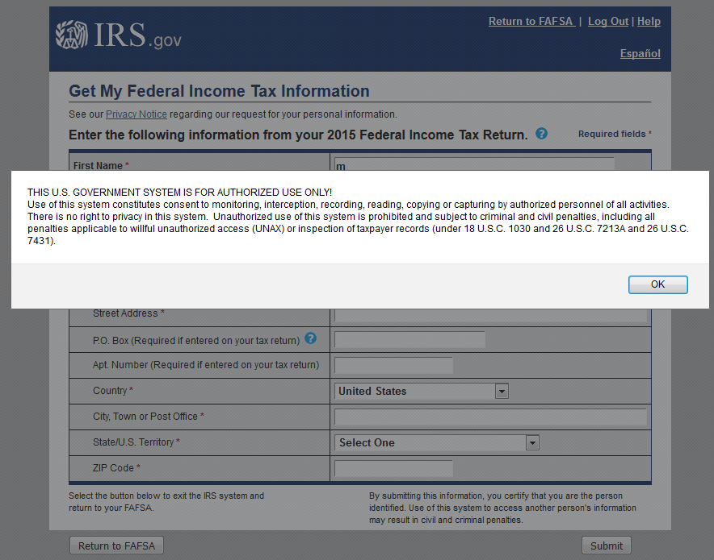
Source: www.fasfa.gov
Notes:
Warning text IRS DRT site is displayed.

Slide 40
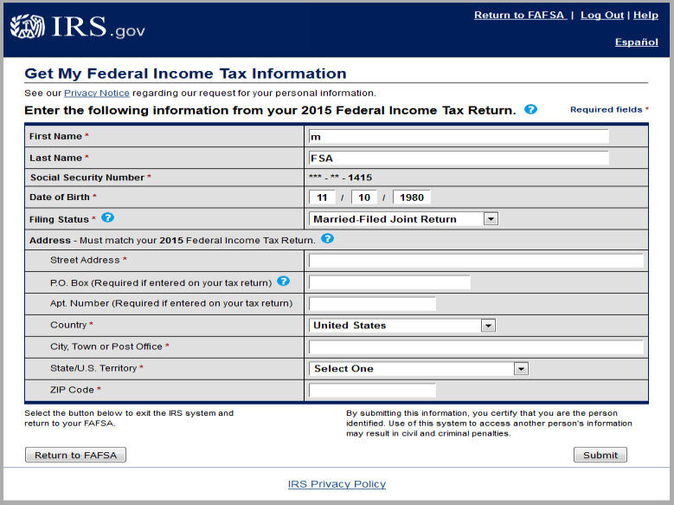
These fields are pre-filled based on FAFSA responses
Source: www.fasfa.gov
Notes:
IRS Data Retrieval Tool, page 1, containing user demographic information.
Even though the fields at the top are pre-filled based on FAFSA responses, the first name, last name, date of birth, and the filing status can be updated on this page. The Social Security Number cannot be updated.

Slide 41
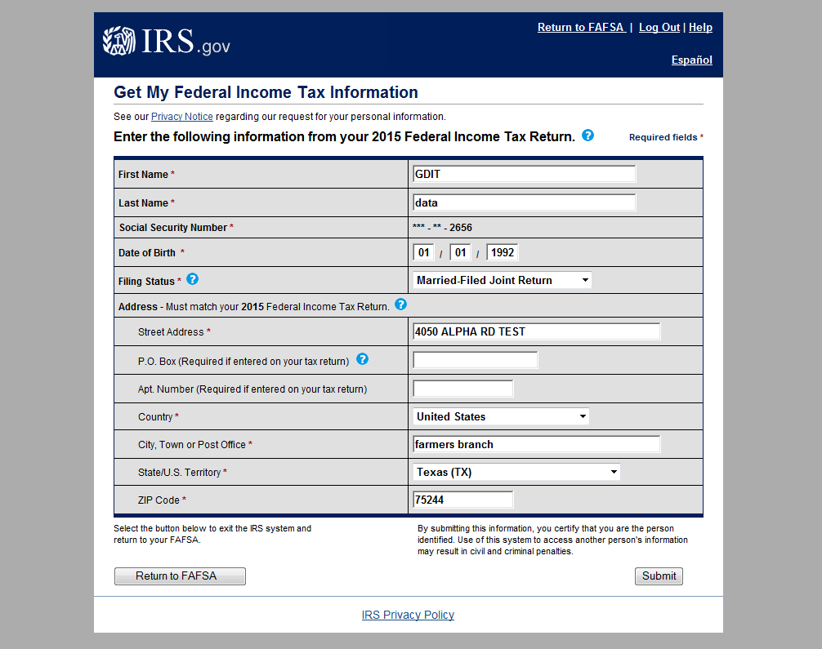
Source: www.fasfa.gov
Notes:
IRS Data Retrieval Tool, page 1, containing user demographic information (continued, updated with user information). The user can click “Submit” to retrieve IRS data, or “Return to FAFSA” to discontinue use of the IRS DRT and return to FOTW.

Slide 42
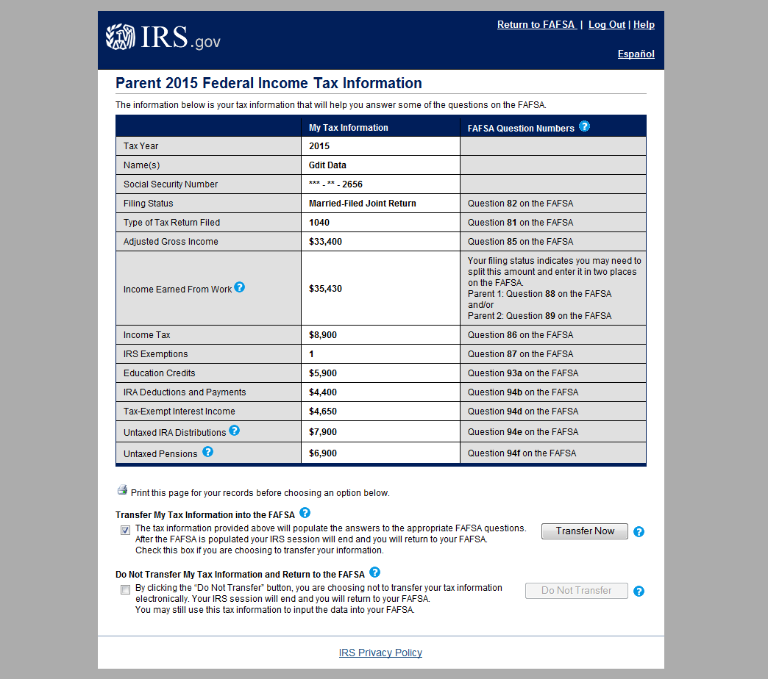
Source: www.fasfa.gov
Notes:
IRS Data Retrieval Tool, page 2, containing user-specific IRS data.
The user can check the “Transfer My Tax Information…” box and click “Transfer Now” to carry this data back into FOTW.
The user can check the “Do Not Transfer…” box and click “Do Not Transfer” to discontinue use of the IRS DRT and return to FOTW.
The user can click the “Print this page” icon in order to print the data that is displayed on this page.

Slide 43
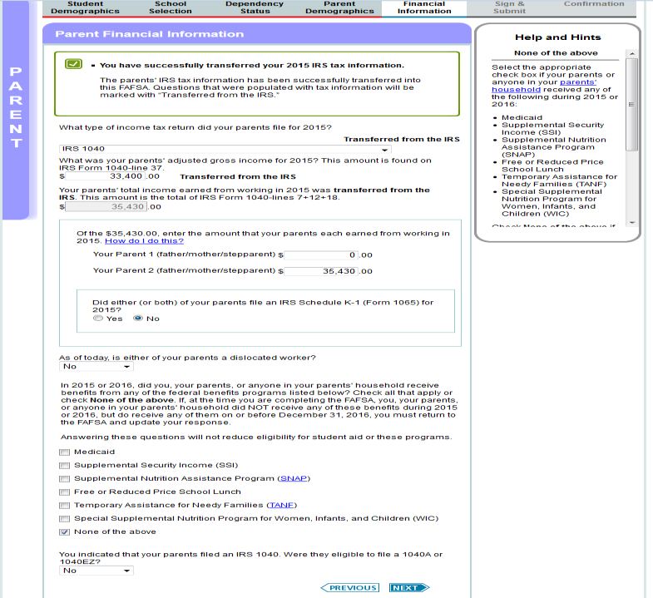
Source: www.fasfa.gov
Notes:
“Parent Financial Information” page.
“Medicaid” has been added as an option under the Federal Means Tested Benefits. On all output documents, this will be listed as part of the Supplemental Security Income (SSI) response.
“School” has been added as part of the “Free or Reduced Price School Lunch” question.

Slide 44
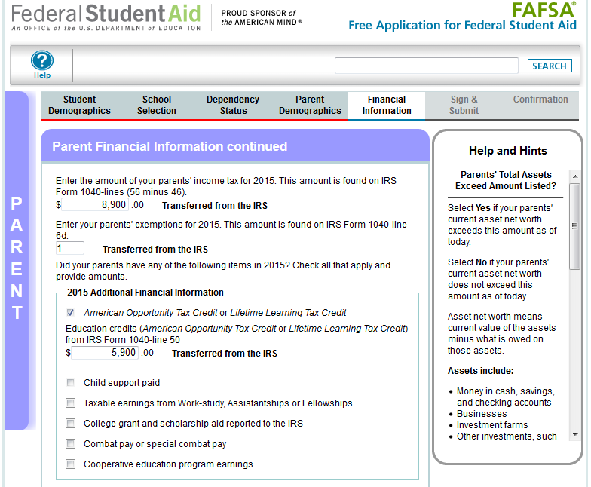
Source: www.fasfa.gov
Notes:
This is the top half of the “Parent Financial Information continued” page. The bottom half of the page is continued on the next slide.

Slide 45
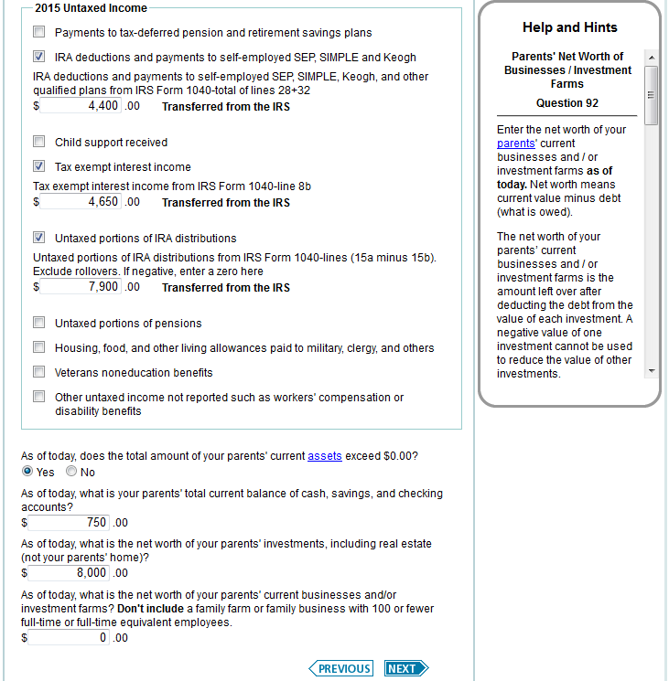
Source: www.fasfa.gov
Notes:
This is the bottom half of the “Parent Financial Information continued” page.

Slide 46
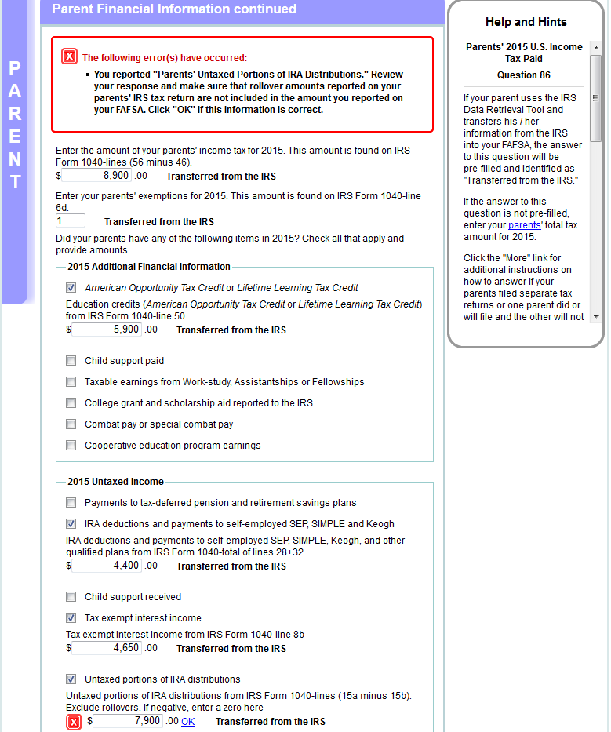
Source: www.fasfa.gov
Notes:
This is the bottom half “Parent Financial Information continued” page.

Slide 47
Yes, if you have worked and received statements of income, you must list all the information the form requests.
The NEXT pages are about your income. Again, be honest in reporting what they ask.

Slide 48
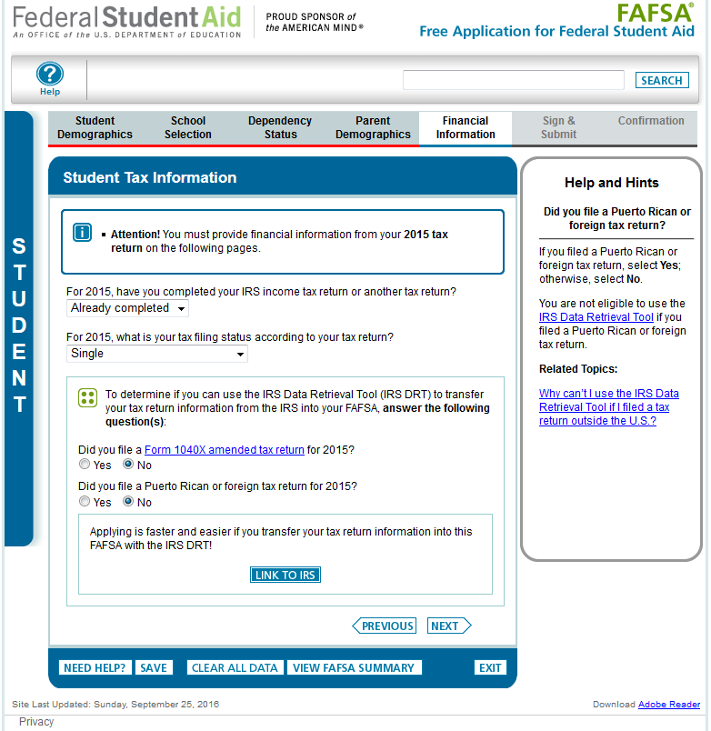
Source: www.fasfa.gov
Notes:
“Student Tax information” page.
New for 2019-20, the 2017 tax information will be requested instead of the 2018 tax information. To emphasize this change for students and parents, an alert message will display indicating “Attention! You must provide financial information from your 2017 tax return on the following pages.”
Additionally, the IRS DRT section of the application has been revised to make the following changes:
The “Did you file taxes electronically in the last 3 weeks (or by mail in the last 11 weeks)?” question has been removed.
Students will not be requested to provide their FSA ID (if not already provided) on the Student Tax Information page prior to clicking “Link to IRS”
The student should click “Link to IRS” rather than “Next” on this page.
The Amended Tax Return and Foreign Tax Return questions have been revised to include 2017 as part of the question.
The definition of the 1040 X amended tax return can be found by following the link that was added to the question.

Slide 49
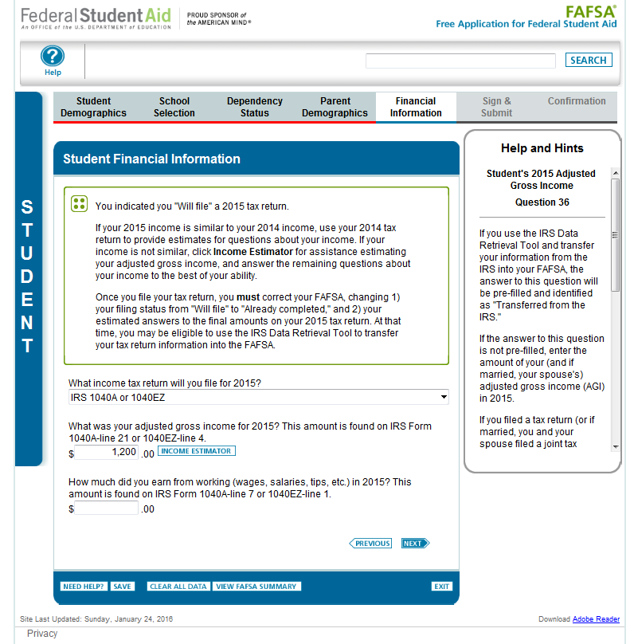
Source: www.fasfa.gov
Notes:
Now Melanie will provide her tax information. Let’s say she earned $1,200.00 by working part-time during the year. She will input that amount as her AGI.

Slide 50
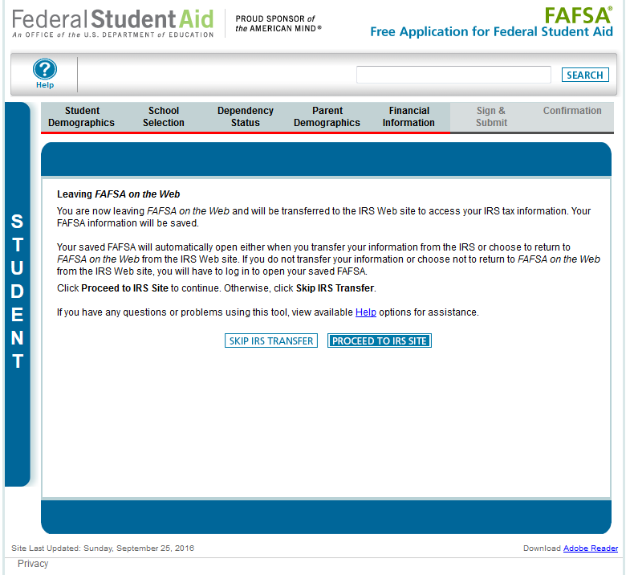
Source: www.fasfa.gov
Notes:
“Leaving FAFSA on the Web” page, displayed when the student is going to the IRS Web site.
The “Leaving FAFSA on the Web” page has been revised to provide information on how to utilize the IRS DRT and what will occur if they opt to not use the IRS DRT.
In this case, the FSA ID for the student was entered when logging into their FAFSA, so it is not requested on this page.

Slide 51
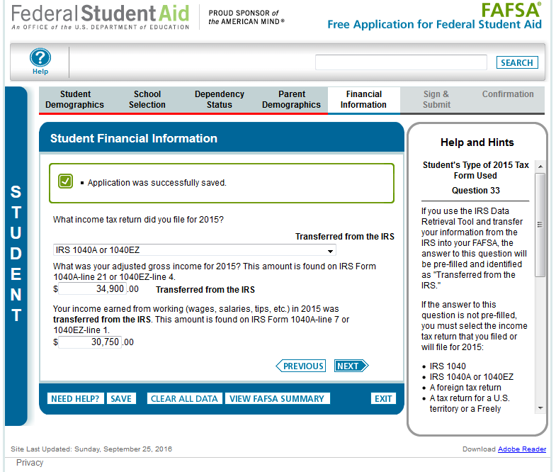
Source: www.fasfa.gov
Notes:
“Student Financial Information” page.

Slide 52
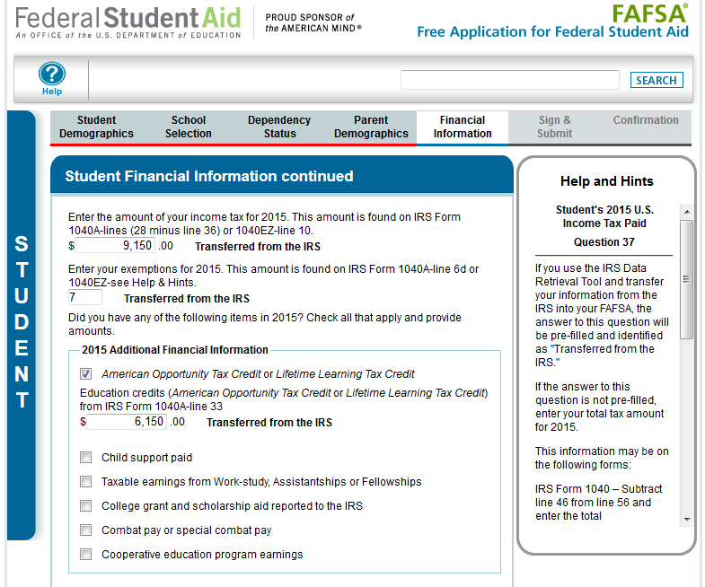
Source: www.fasfa.gov
Notes:
Top half of the “Student Financial Information continued” page. Bottom half of the page is continued on the next slide.

Slide 53
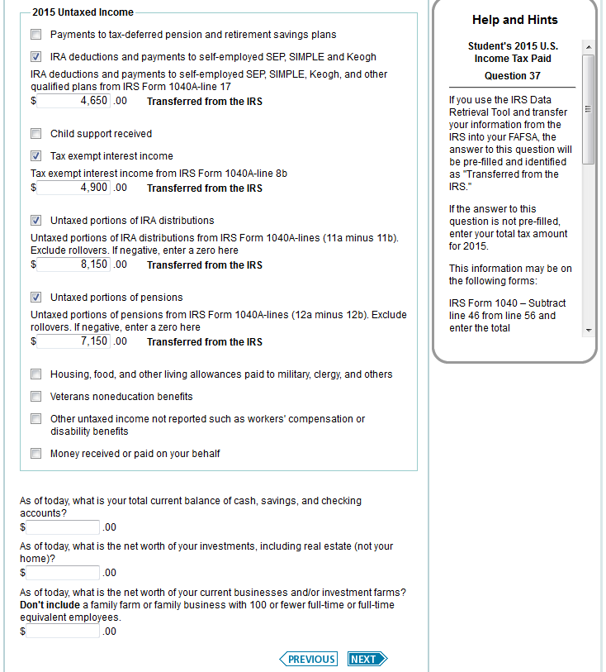
Source: www.fasfa.gov
Notes:
This is the bottom half of the “Student Financial Information continued” page.

Slide 54
Getting close to the end! Be sure to read all information before signing out of the application.

Slide 55
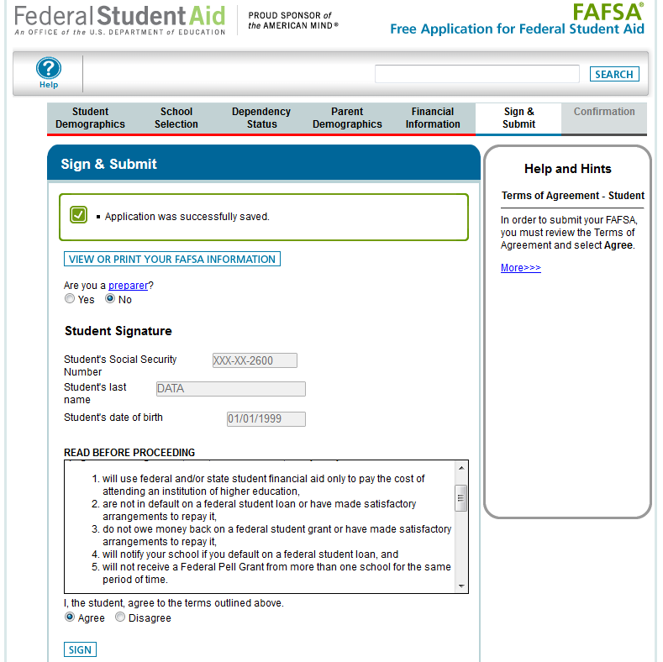
Source: www.fasfa.gov
Notes:
This is the top half of the “Sign & Submit” page, where the student signs and actively acknowledges the Certification Statement. Applicants must still actively agree with the certification statement.
Since the student entered his/her FSA ID to go to the IRS to transfers data, he/she is not requested to provide his/her FSA ID Username and Password again to sign the application.

Slide 56
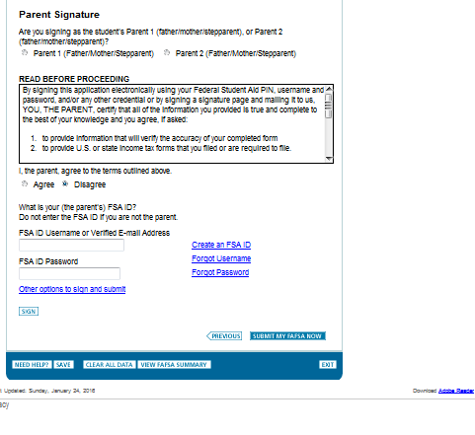
Source: www.fasfa.gov
Notes:
In this case, Melanie’s Dad, who is Parent 1, will sign the FAFSA using his assigned FSA ID. He indicated Agree to the Terms of Agreement.
NOTE: At the bottom of this screenshot, you will see that there is a link for other options to sign and submit. For example, one option is to print the signature page and mailed it to Central Processing System.

Slide 57
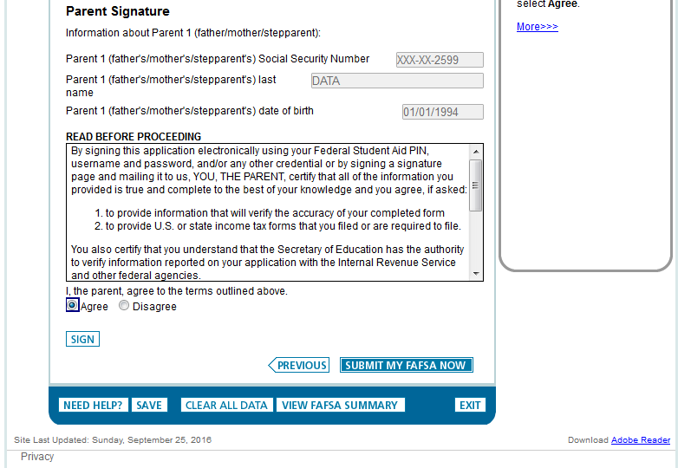
Source: www.fasfa.gov
Notes:
This is the bottom half of the “Sign & Submit” page for the dependent student, with the parent signature options and the active confirmation for the parent Certification Statement.
Since the student entered his/her FSA ID to go to the IRS to transfer data, he/she is not requested to provide his/her FSA ID Username and Password again to sign the application.

Slide 58
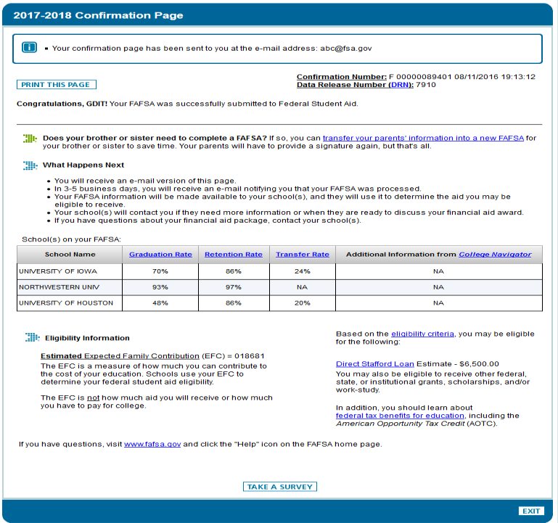
Source: www.fasfa.gov
Notes:
“Confirmation Page”
Parents of dependent students are offered the option to transfer the parents’ data into another student’s new FAFSA. The link is found on the “Confirmation Page.”
If the applicant leaves the confirmation page before they click this link they will not be able to return to transfer data to the application of a sibling.

Slide 59
FSAIC
The Federal Student Aid Information Center (FSAIC) operates a toll-free hotline to provide comprehensive assistance in English, as well as Spanish on:
General information about federal student aid (Title IV programs)
The FAFSA application (paper and online);
FAFSA corrections;
Student loan history
1-800-4-FED-AID (1-800-433-3243)
www.StudentAid.gov
www.FAFSA.gov
Hours:
Monday through Friday
8:00a.m. – 11:00p.m. ET
*Extended hours may be available*

